Slide 1
IST 722 Final Project Presentation
Ammi Dumalagan, Damon Porter, Holden Herrell, and Maryse Khoury

Slide 2
Table of Contents
Business Processes
Star Schema
Pivot|Power BI Visuals
Summary
Recommendations

Slide 3

Business Processes
Simple
FudgeFlix View Count
Summary of movie rentals by view count
FudgeFlix Rental Duration
Summary of rental duration (physical rentals) and time from queue to watch date (digital rentals)
Complex
Consolidated Sales
Combined sales/rentals for FudgeMart and FudgeFlix
Common Customer Sentiment (Tweets)
Sentiment from tweets of customers common to both FudgeMart and FudgeFlix

Slide 4

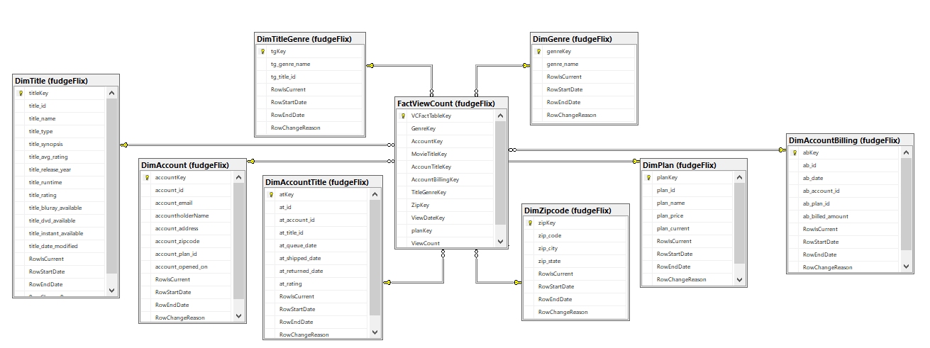
Star Schema
Fact View Count

Slide 5
Star Schema
Fact Consolidated Sales

Slide 6

Pivot|Power BI Visuals
Fact View Count

Slide 7
Pivot|Power BI Visuals
Fact View Count

Slide 8
Pivot|Power BI Visuals
Fact Consolidated Sales

Slide 9
Pivot|Power BI Visuals
Fact Consolidated Sales

Slide 10

Summary

Slide 11

Recommendations

